Slide 2
Build Code Lab UWP Development 3: Building Connected Mobile Experiences: Cloud and App to App
L726
Andy Wigley @andy_wigley
Mike Taulty @mtaulty

Slide 3
Proctors
Proctors are here to help you!
Raise your hand if you need any assistance
Jason Short DX
Juliette Weiss Design
Kelsey Huebner DX
Cory Hendrixson Windows Development Group
Travis Wilson Windows Development Group
Vishwac Sena Kannan Windows Development Group
Francis Zhou Inking
Dorrene Brown Cortana
Shawn Henry Windows Development Group
Paul Rambo Windows Development Group

Slide 4
UWP Lab Modules
1
Building an Adaptive UI
2
More Personal Computing
(Follows on from Module 1, but can be done independently)
3
Building Connected Mobile Experiences: Cloud and App to App (Follows on from Module 2, but can be done independently)
Notes:
“As a follow-on to this lab, we also have the Azure IoT lab. In that, you’ll learn how to use the Raspberry Pi to send sensor data to IoT Hub and process it using other Azure IoT services.
If you are interested in the underlying IO and other capabilities on devices like the Raspberry Pi, or want to explore more with Azure and devices, we also have the Open Hack in this same room, starting on Day 2.”

Slide 5
UWP Code Lab Related Sessions Wednesday 03/30
11:30 – 12:30 | Universal App Model Overview: What’s New in the UWP App Model Marriott 9
14:00 – 15:00 | What’s New in Windows UI/UX for Universal Windows Apps Moscone 2004
15:30 – 16:30 | Bringing Existing Desktop Applications to UWP Moscone 2004
17:00 – 18:00 | Windows Store and Dev Center Overview: New Capabilities for Helping Developers Succeed Moscone 2001

Slide 6
UWP Code Lab Related Sessions Thursday 03/31
11:30 – 12:30 | What’s new in Visual Studio for UWP Developers Marriott 7
14:00 – 15:00 | Pen and Inking: Inking at the Speed of Thought Marriott 8
15:30 – 16:30 | Creating Beautiful UX in a Real World App with Visuals, Animations and Effects Moscone 2001
17:00 – 18:00 | Building Great UWP Apps for Xbox Marriott 8 | Cortana: Step-by-Step on How to Teach Cortana to Proactively Engage with your App Moscone 2005
18:30 – 19:30

Slide 7
UWP Code Lab Related Sessions Friday 04/01
09:00 – 10:00 | Universal Windows Application Lifecycle: From Activation to Background Execution, Multitasking and Extended Execution Moscone 2005
10:30 – 11:30 | HoloLens: Building UWP 2D Apps Marriott 9
12:30 – 13:30
14:00 – 15:00 | Continuum for phone: Optimizing Windows apps across screens Moscone 2001

Slide 8
In this module…

Slide 9
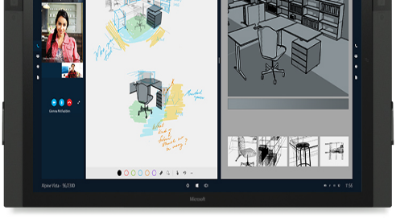
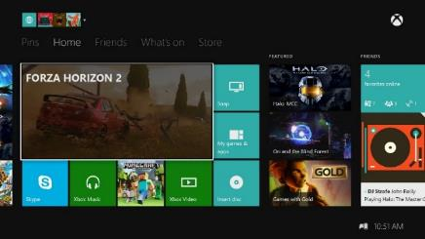
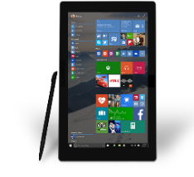
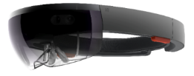

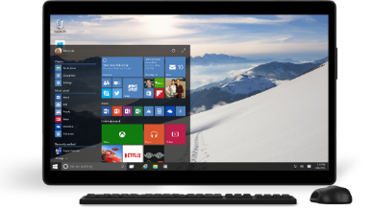
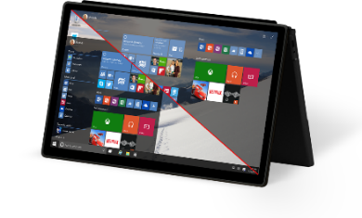
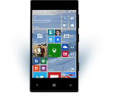
Mobile Experiences - not just mobile devices
The Experience you want on the device you want
User is the center of the experience, not the device.
Available on the right device at the right time
Input model optimized for the experience.
Enabling Mobile Experiences with Universal Apps
User
Notes:
Increasingly, end users are itching to break out of these constraints and have truly mobile EXPERIENCES where they can bring the experience with them to whatever device is most convenient or productive to use.
People want to be at the center of the experience – not their device. If there is a big screen and you want to share an experience with a group – you should be able to bring the experience to that screen.
End users want their experiences available on the right device at the right time – allowing them the simplicity of sharing and collaboration.

Slide 10
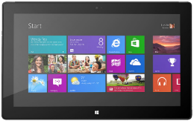
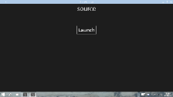
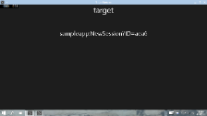



App to App
Launching other apps
Integrating with other apps
var options = new LauncherOptions();
options.TargetApplicationPackageFamilyName = "24919.Instap";
var launchUri = new Uri("instapaper:?AddUrl=http%3A%2F%2Fbing.com");
await Launcher.LaunchUriForResultsAsync(launchUri, options, data);
App1
App2

Slide 11
Getting setup…

Slide 12
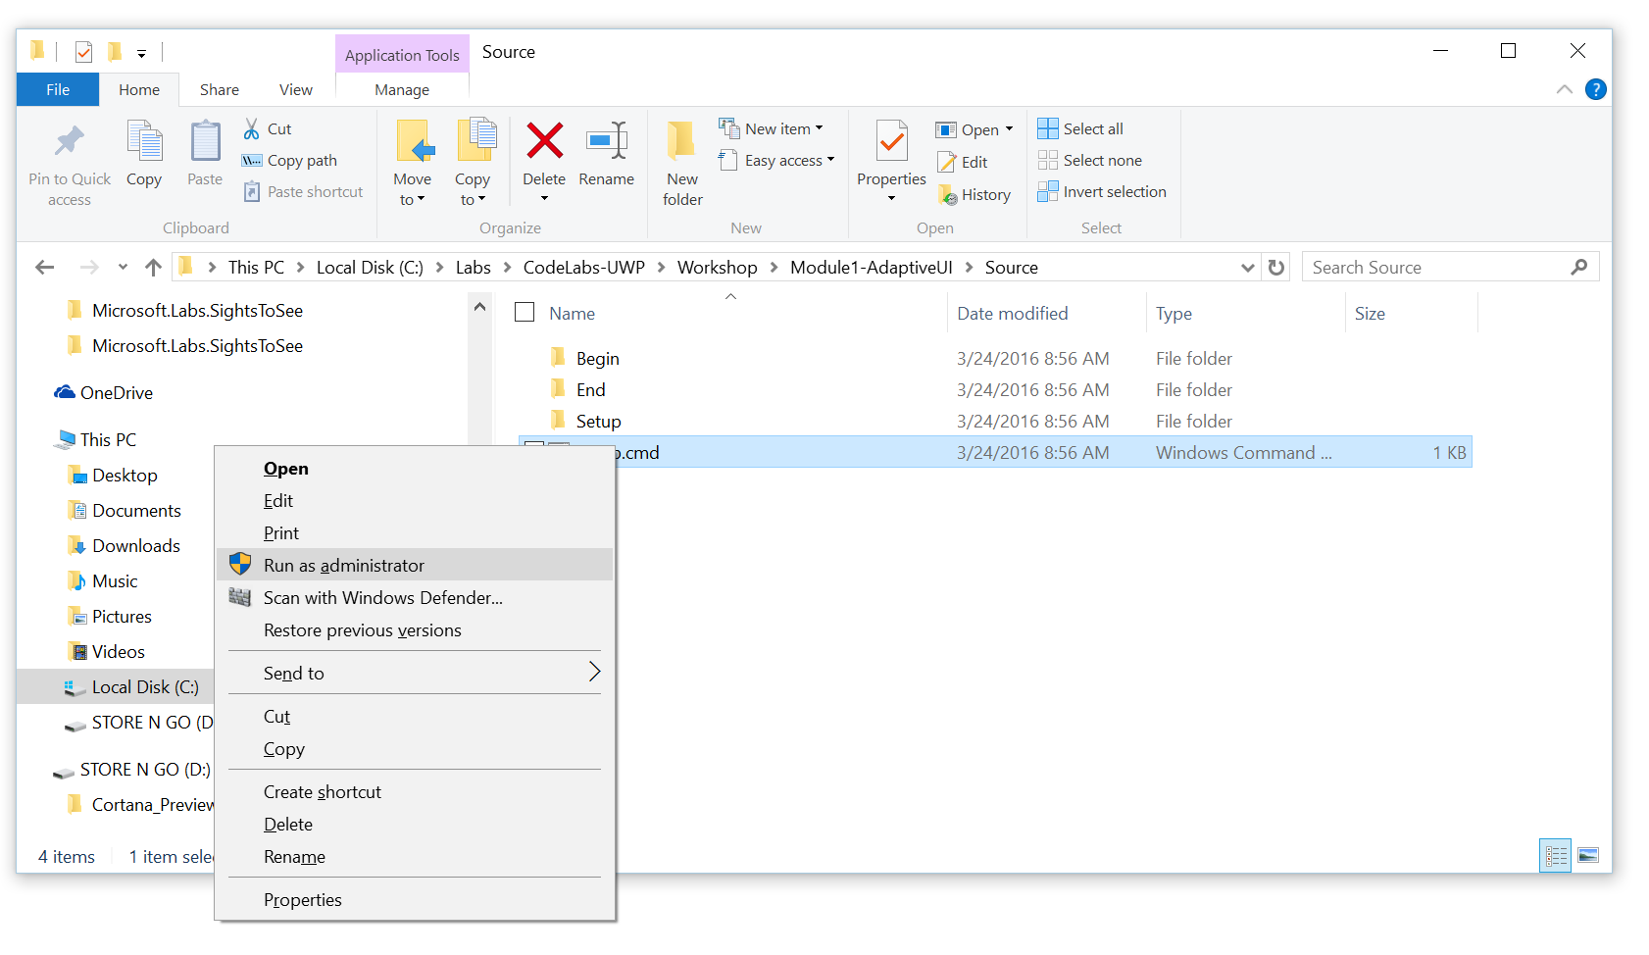
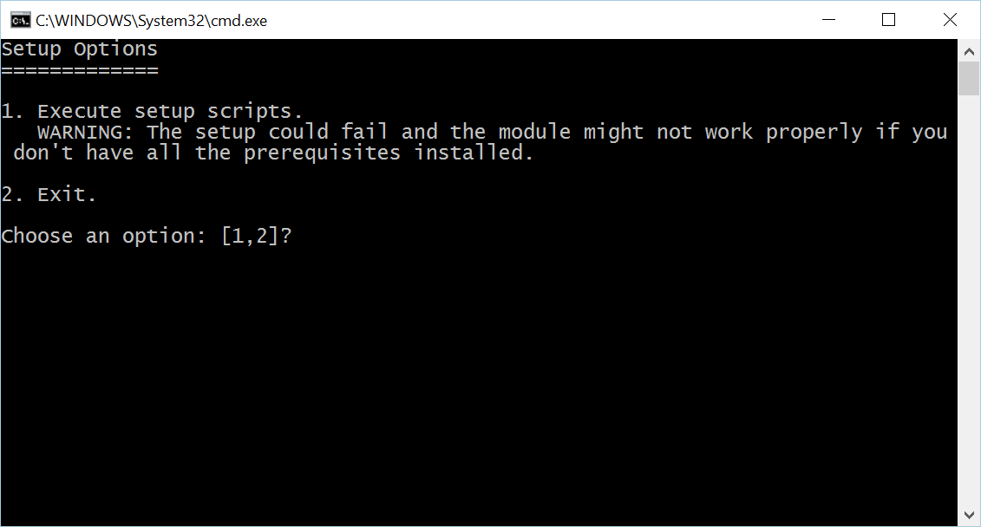
Install Code Snippets
Go to C:\Labs\CodeLabs-UWP\Workshop\Module1-AdaptiveUI\Source
Right-click on Setup.cmd, click on Run as administrator
Click Yes at the User Account Control prompt
Select option 1 in the command window

Slide 13
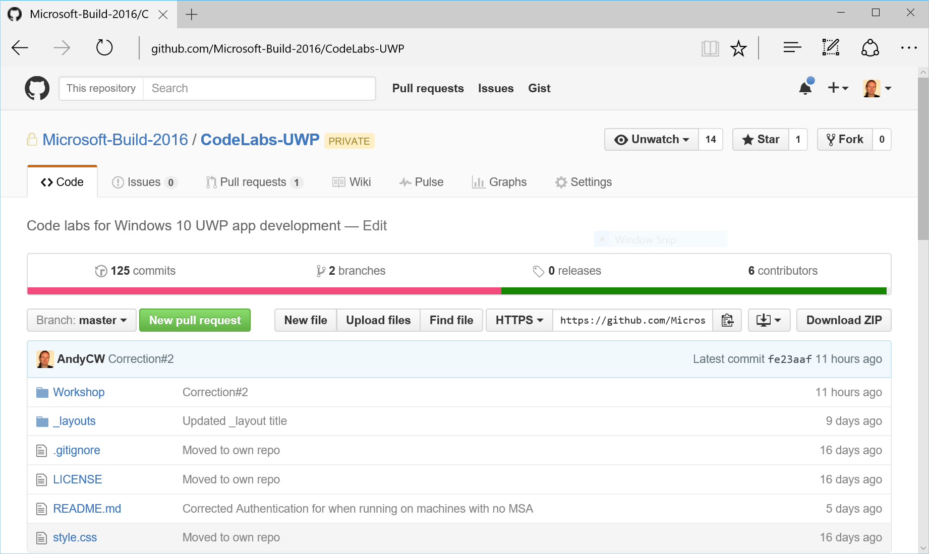
View lab manual
On your desktop, click the UWP CodeLabs icon to open the browser at the Github repository for these labs: https://github.com/Microsoft-Build-2016/CodeLabs-UWP
Click on Workshop folder

Slide 14
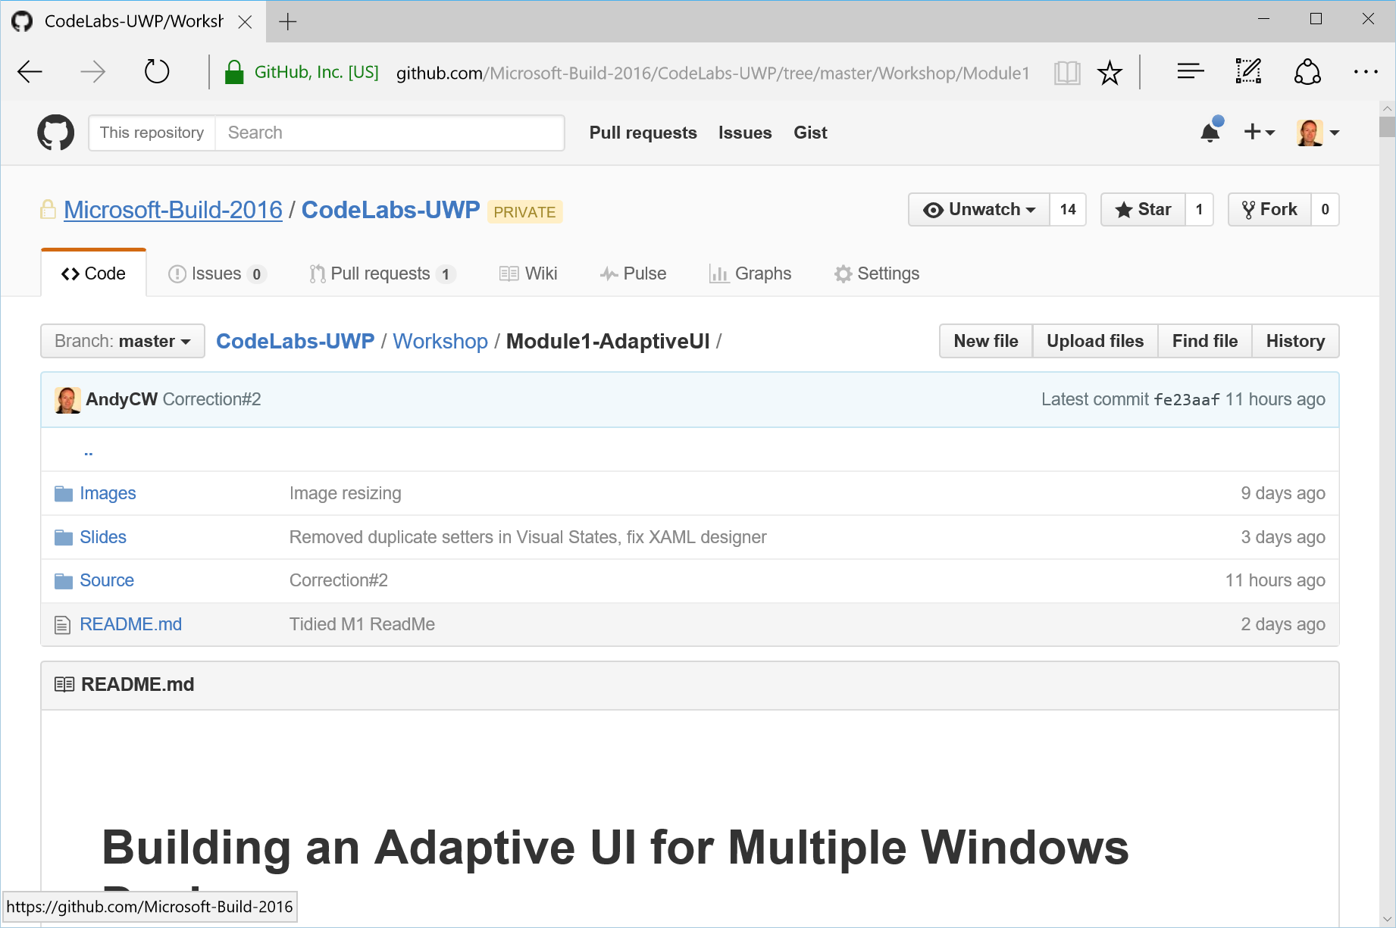
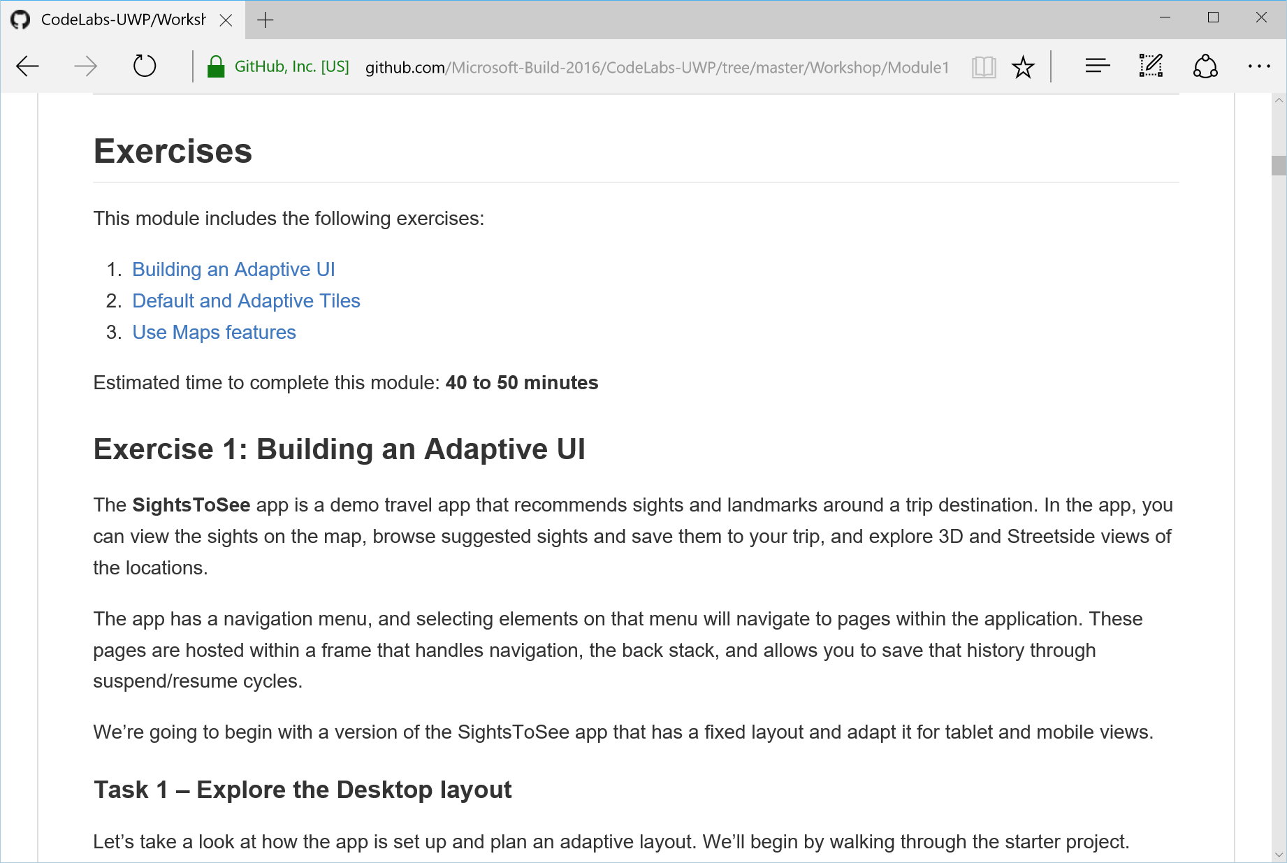
View lab manual
Click on the folder for the current module
Scroll down for the README.md – this is your lab manual

Slide 15
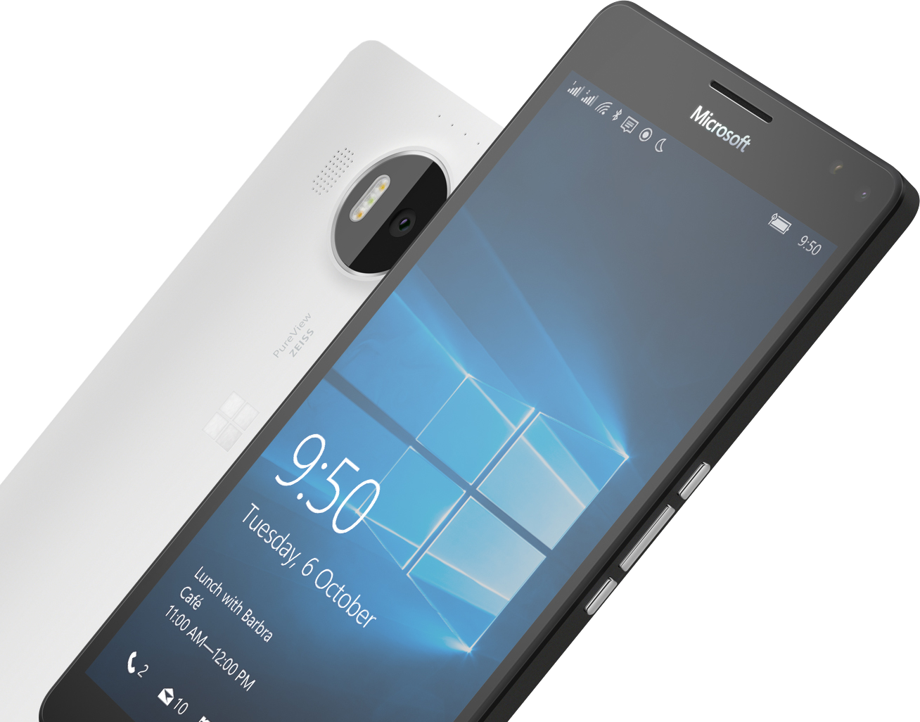
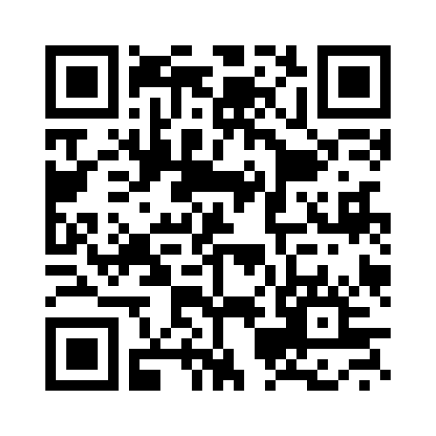
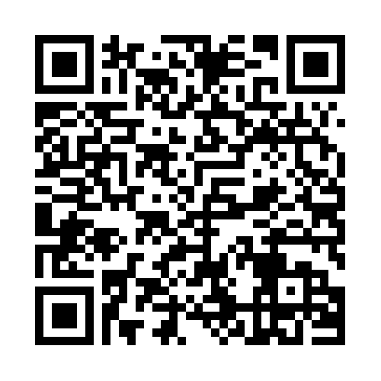

Please Complete An Evaluation Form Your input is important!
SAMPLE
or
Notes:
Update phone image to a Microsoft phone.

Slide 16
Evaluate this session
SAMPLE
Notes:
Speakers: Please note this slide will be updated with your session’s QR code during the scrub process which is outlined on side 3. Attendees can scan the QR code for access to your session’s eval.

